Slide 1

PRESENTATION - URBAN HEALTH ENVIRONMENT CONSULTANT TOOL
CSE583 Team Project Eva (Jiafei) Zhang | Aishwarya | Jingheng Chen | Sam Wang

Slide 2

CONTENT
URBAN HEALTH INDEX
UW CSE 583 COURSE PROJECT
User Investigation
MVP Demo
Tech Review
Challenges
Further Steps
URBAN HEALTH ENVIRONMENT CONSULTANT TOOL
User Investigation
Tech Review
Challenges
Further Steps
Slide 00/08
MVP Demo

Slide 3

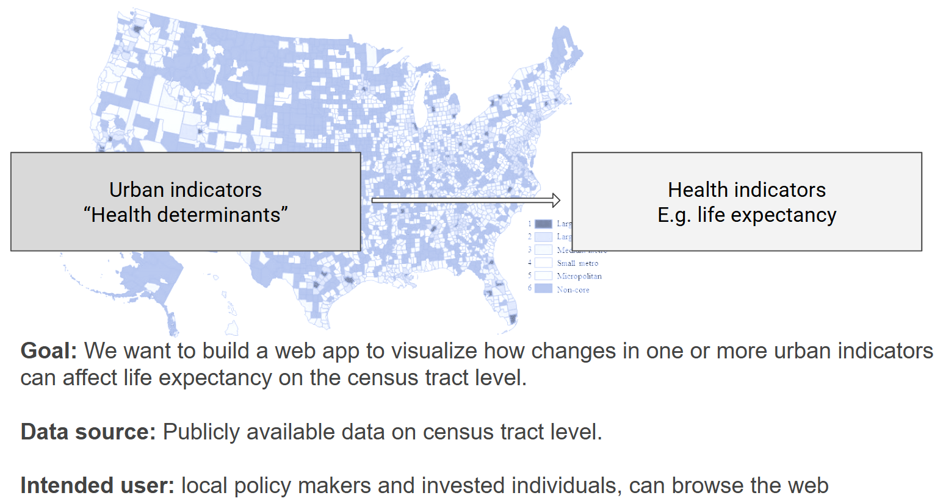
URBAN HEALTH INDEX
UW CSE 583 COURSE PROJECT
Idea & User
URBAN HEALTH ENVIRONMENT CONSULTANT TOOL
User Investigation
Tech Review
Challenges
Further Steps
Slide 01/08
MVP Demo

Slide 4
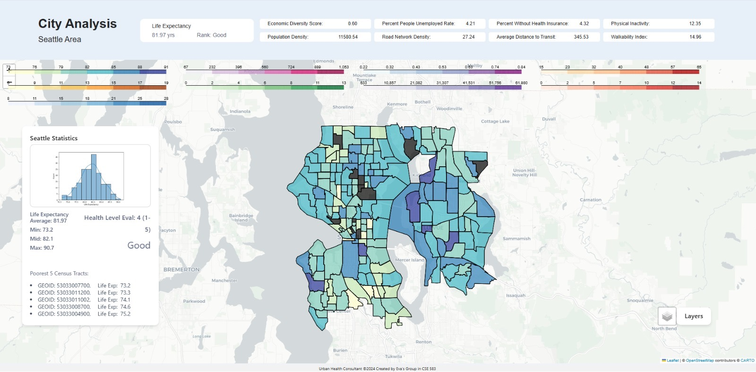
Design cont. & Use Case
URBAN HEALTH INDEX
UW CSE 583 COURSE PROJECT
Policy Evaluation
Use Case: Policymakers can use the app to identify census tracts with the lowest life expectancy and related socioeconomic indicators. This helps in prioritizing resource allocation and designing targeted interventions.
Example: A city council uses the app to increase walkability and improve healthcare access in census tracts with "Very Poor" life expectancy.
Example: An NGO uses the app's comparison tools to showcase disparities and lobby for changes in specific neighborhoods.
URBAN HEALTH ENVIRONMENT CONSULTANT TOOL
User Investigation
Tech Review
Challenges
Further Steps
Slide 02/08
MVP Demo

Slide 5
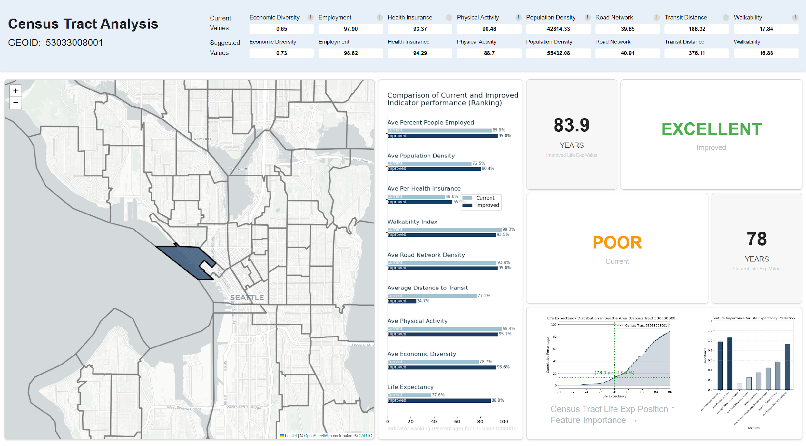
Design cont. & Use Case
URBAN HEALTH INDEX
UW CSE 583 COURSE PROJECT
Public Awareness
Use Case: The app can inform residents about their community's health metrics and how they compare to city-wide averages.
Example: Residents use the app to understand the need for improved physical activity programs or better health insurance enrollment.
URBAN HEALTH ENVIRONMENT CONSULTANT TOOL
User Investigation
Tech Review
Challenges
Further Steps
Slide 03/08
MVP Demo

Slide 6
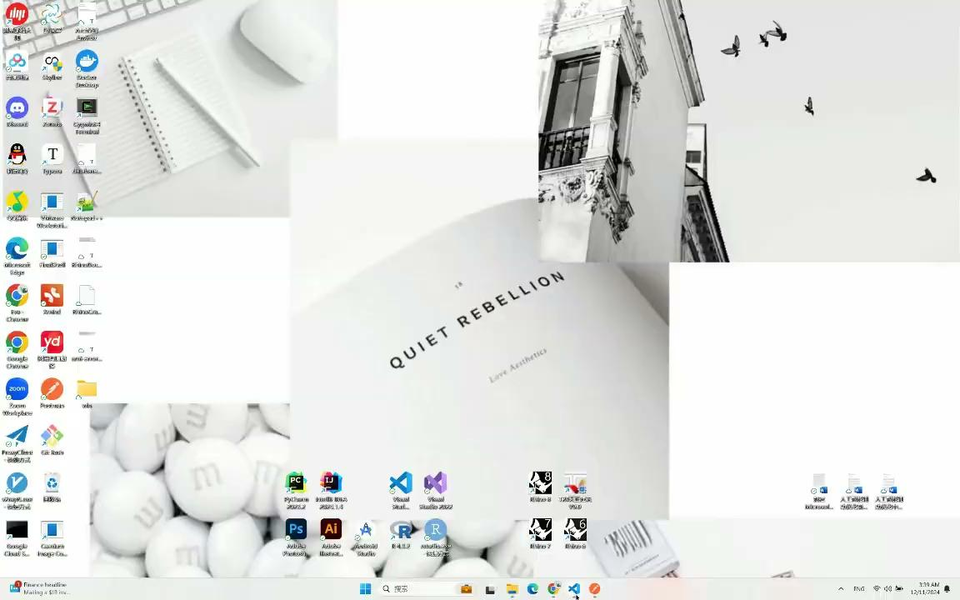
Demo
Video
URBAN HEALTH INDEX
UW CSE 583 COURSE PROJECT
URBAN HEALTH ENVIRONMENT CONSULTANT TOOL
User Investigation
Tech Review
Challenges
Further Steps
Slide 04/08
MVP Demo

Slide 7
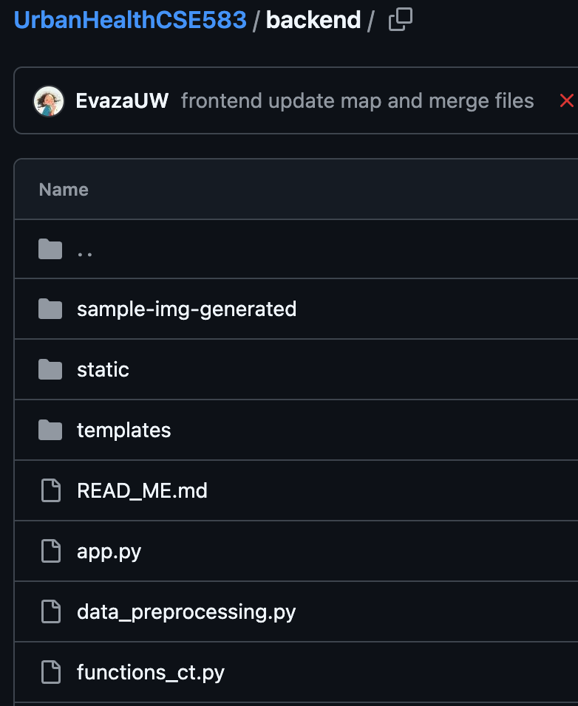
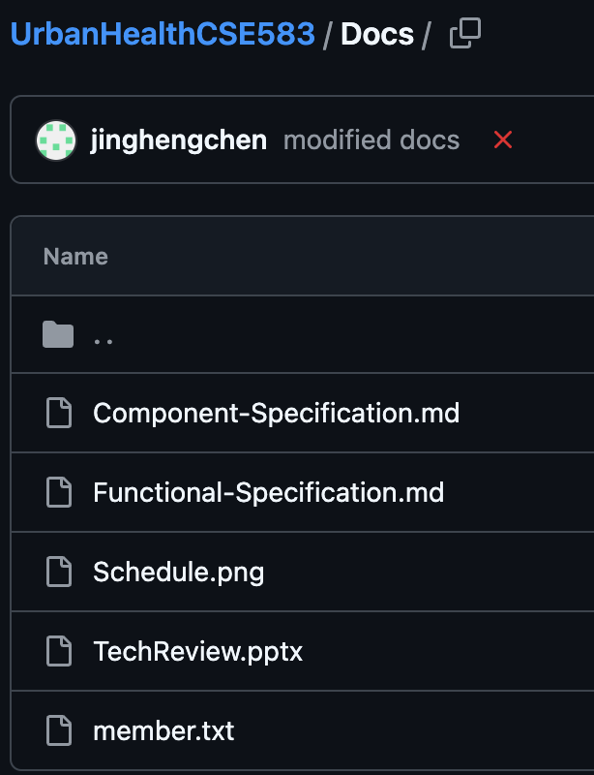
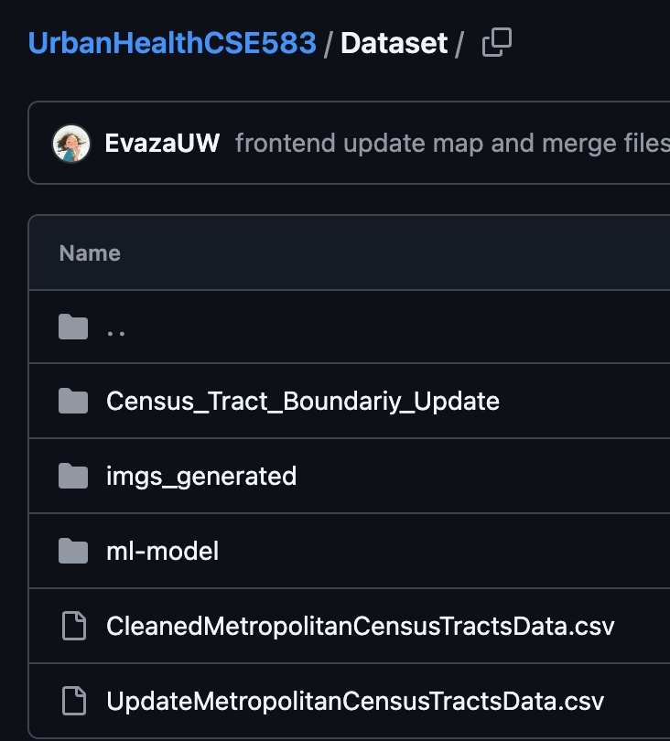
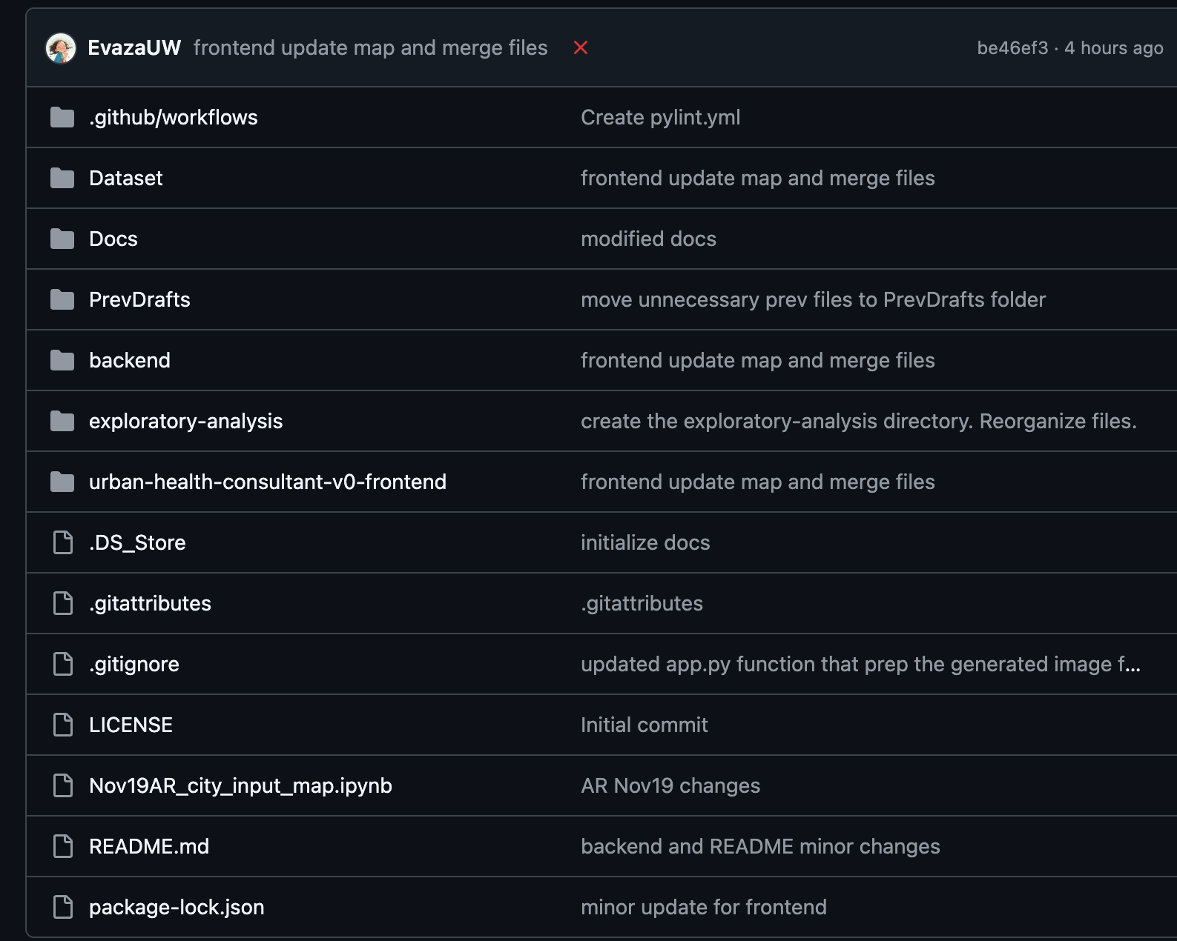
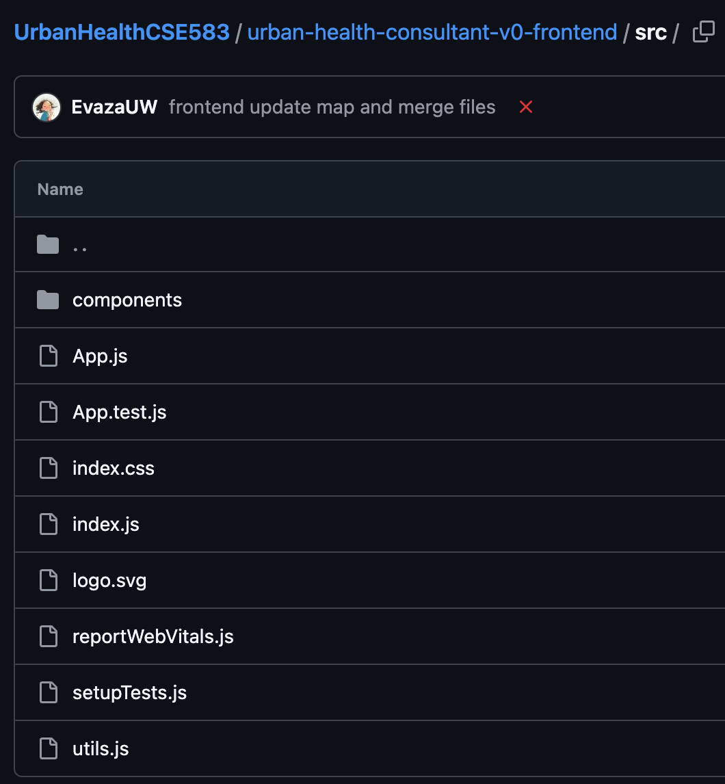
Github Project Structure
URBAN HEALTH INDEX
UW CSE 583 COURSE PROJECT
Dataset
Frontend + Backend
Docs
URBAN HEALTH ENVIRONMENT CONSULTANT TOOL
User Investigation
Tech Review
Challenges
Further Steps
Slide 05/08
MVP Demo

Slide 8

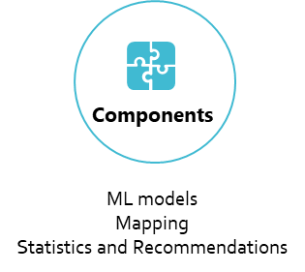
Tech Review
URBAN HEALTH INDEX
UW CSE 583 COURSE PROJECT
Tech Stacks | Choices
A web application framework | Flask, Python Shiny, Django
Frontend Web Page | React, Angular, Vue,
Database | MySQL, SQL server, PostgreSQL
Components | Available tech choices py
ML models | Scikit-learn
Data analysis and recommendations | Pandas, matplotlib, seaborn …
Interactive map | Folium, plotly, pyleaflet
Feature | Flask | Django | Pyramid
Flexibility | Highly flexible, minimalistic | Less flexible, follows "the Django way" | High flexibility, configurability
Use Case | Small to medium web apps, microservices | Large applications, built-in admin panel | Medium to large applications
Performance | Generally fast, depending on extensions | Slightly slower due to heaviness | Good, optimized for larger apps
Scalability | Good with proper architecture | Good, designed for scalability | Very good with configurability
Feature | React | Vue | Angular
Learning Curve | Moderate | Easy | Steep
Performance | High (with optimizations) | High | High
Scalability | Highly scalable with proper Arch | Good | Designed for scalability, complex apps
URBAN HEALTH ENVIRONMENT CONSULTANT TOOL
User Investigation
Tech Review
Challenges
Further Steps
Slide 06/08
MVP Demo

Slide 9

Challenges
URBAN HEALTH INDEX
UW CSE 583 COURSE PROJECT
Frontend ⇔ Backend data transfer
Numeric Data; Image Data
Interactive map
Other user interactions:
City choosing,
page loading,
…
ML Model
Indicator evaluations
User interaction javascript elements integration with python analysis functions;
Indicator improvement recommendations
URBAN HEALTH ENVIRONMENT CONSULTANT TOOL
User Investigation
Tech Review
Challenges
Further Steps
Slide 07/08
MVP Demo

Slide 10

Next Steps
URBAN HEALTH INDEX
UW CSE 583 COURSE PROJECT
Current phase optimization: corner cases check and test, map interaction refinement, do better with style check; Add contemporaneous data and further develop application for web based tool usage; conduct HCI surveys
Next phase: consider the scalability, build the database and use cloud to store resources; add interaction to graphs, like enable users to play toolbars to change indicators and see the result; implement more use cases and make it more user friendly with high performance.
Next Next Next Phase: adding some playground for users to make changes on satellite image, etc, to see how retrofitting strategies at cities level can influence the health performance.
URBAN HEALTH ENVIRONMENT CONSULTANT TOOL
User Investigation
Tech Review
Challenges
Further Steps
Slide 08/08
MVP Demo

Slide 11
THANKS

